Slide 1
ICCA and ARA
September 24, 2024
ICCA NA Board Meeting
Donnie Taylor
Sr. Vice President Member Services & Corp. Relationships
dtaylor@aradc.org 925-899-1906

Slide 2
What would you like to discuss or know concerning ARA?

Slide 3
How do you see the relationship between ICCA and ARA?
Retailers Employ CCA Agronomists
CCA Agronomists Add Creditability to Retailers
CCA Agronomic Recommendations Add Margin to Product Sales
Value Added Retailers Provide Value for Certification
CCA are the Translators of Science to Profitable Production
ARA Touts Value of CCA’s at all Washington Agencies
Retailer and CCAs Continue to Value Continuous Education
CCA’s and Retailers are the Educators of Sustainability Profitable Practices

Slide 4
Vision & Mission ARA
Vision (who we are)
ARA is the recognized unified national voice and trusted resource for agricultural retailers and distributors.
Mission (what we do)
ARA unites its members and their interests to advocate and educate on their behalf, provide services to improve their businesses, and preserve their freedom to operate and innovate, ensuring a safe and plentiful food supply for all.

Slide 5
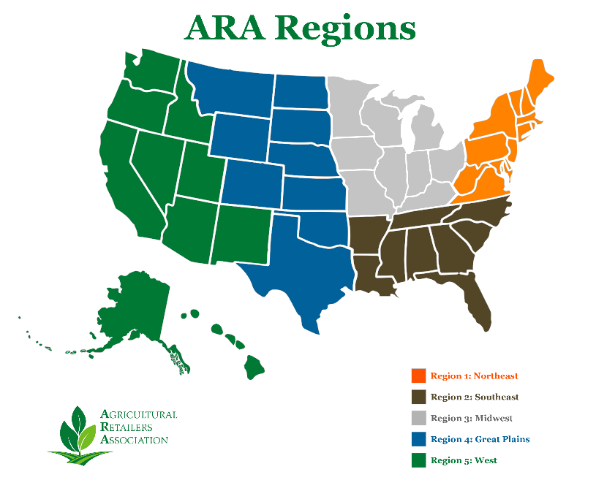

Slide 6
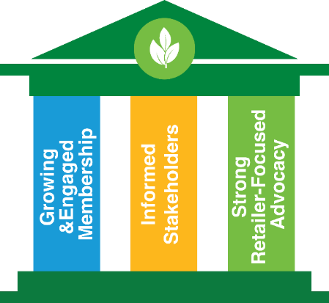
Strategic Goals
Advocacy
Develop and Strengthen relationships with policymakers and allies driven by ARA member priorities.
Increase engagement in advocacy by employees of ARA member companies.
Identify and effectively engage policy issues that matter to ag retailers.
Membership
Demonstrate the indispensable value of ARA membership to ag retailers and suppliers dedicated to a successful business.
Stakeholders
Members, partners, allies, policymakers and other stakeholders trust ARA to be a reliable and timely source of information. Members are able to access information they need from ARA easily and quickly, and the information gets to the right place in member organizations.

Slide 7
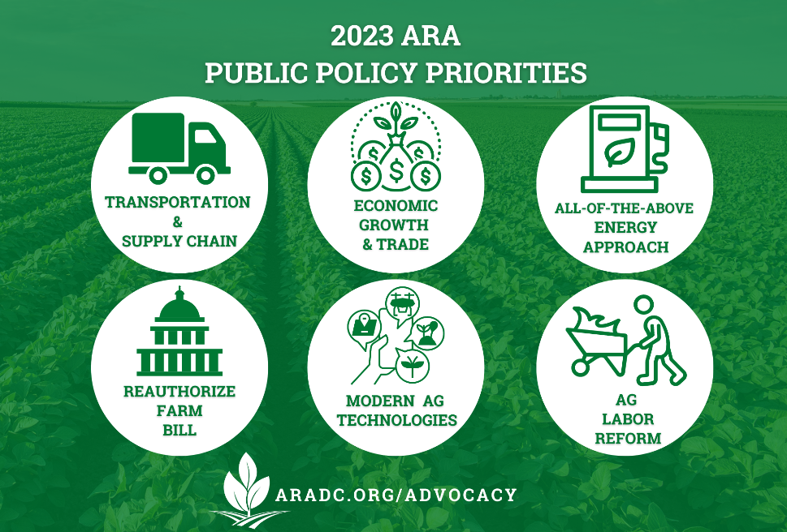

Slide 8
EPA = Endangering Production Agriculture

Slide 9
EPA Office of Pesticide Programs: Key Topics
Pesticide Registrations
Bulletin Live Notices (Issues for farmer and ag retailer)
Corn Refuge Acres?
Existing Stocks Provisions
Label Reform
Application Exclusion Zone (AEZ) Revised Proposal
Federal and State Pesticide Preemption
NPDES Pesticide General Permit Recent Settlement
Endangered Species Act Working Group

Slide 10
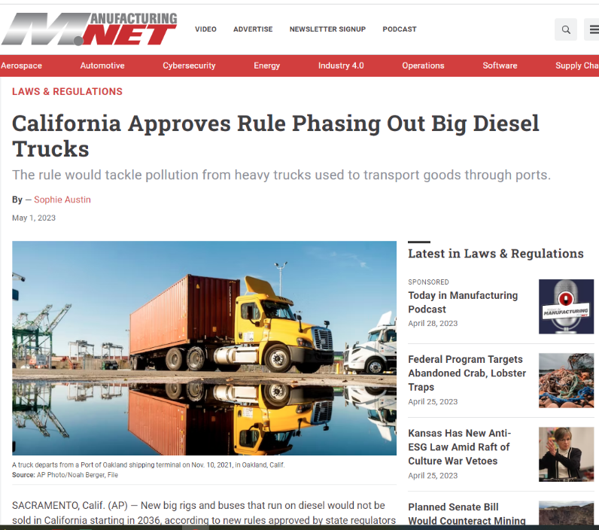

Slide 11
ARA Policies Specific to ICAA
Pesticide ESA work to make sure CCAs are added to pick list
Farm Bill language around TSPs

Slide 12
ARA Farm Bill Priorities
Crop Insurance
Conservation
Biostimulants
Federal and State Pesticide Preemption
NPDES Permits
Broadband Infrastructure
Research

Slide 14
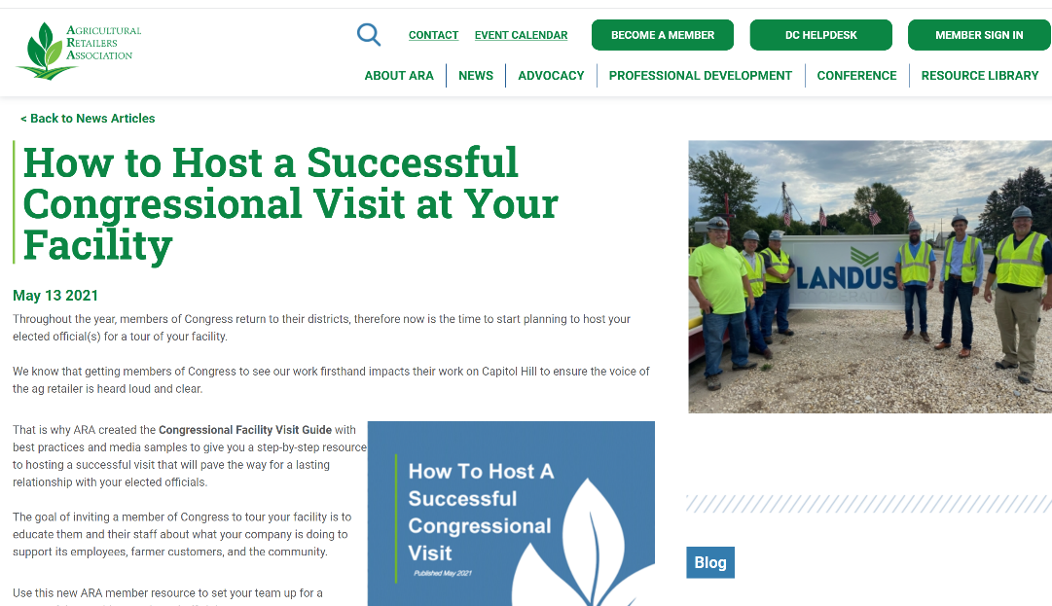

Slide 15
Why ARA?
Leverage and magnify your Voice
Networking opportunities
Up-to-the-minute updates from Capitol Hill and regulatory agencies
Influence policy outcomes
Expand knowledge network
Industry visibility
Professional development programs
Be recognized for achievements
Cost effective extension of staff
Leadership opportunities

Slide 16
Connect with the Agricultural Retailers Association (ARA)
Contact us at info@aradc.org.
Go to www.aradc.org to learn more.
Follow us on social media.
4201 Wilson Blvd. Suite 700 Arlington, VA 22203 T 202.457.0825

